Slide 1




2020
2021

Slide 2
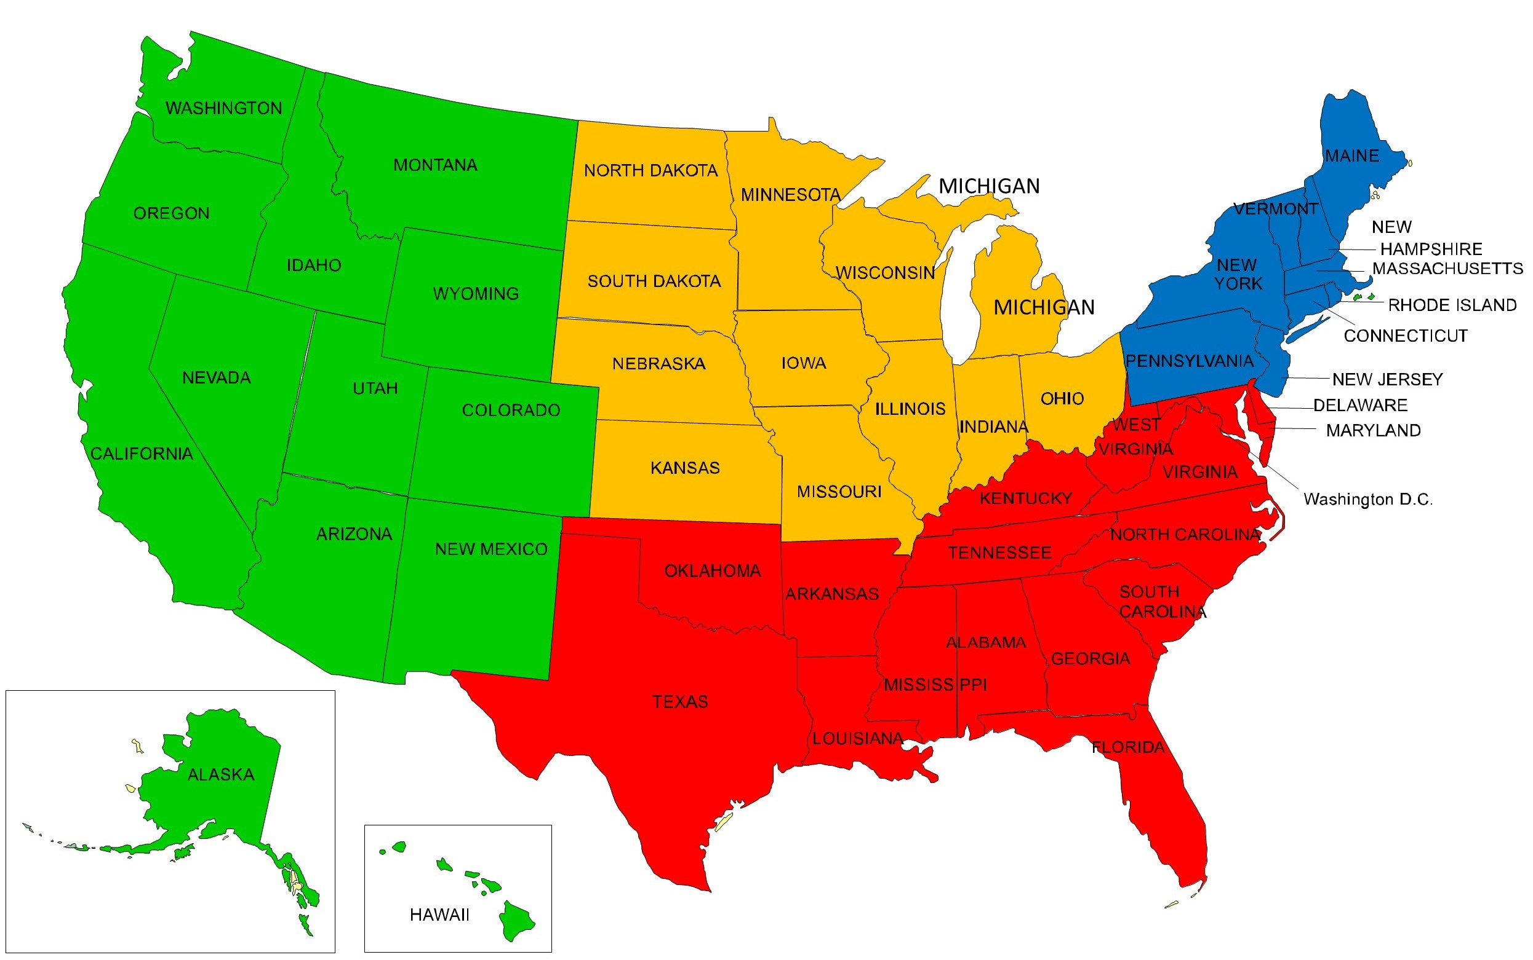
4 U.S. Regions
Northeast
Connecticut
Maine
Massachusetts
New Hampshire
New Jersey
New York
Pennsylvania
Rhode Island
Vermont
South
Alabama Mississippi
Arkansas North Carolina
Delaware Oklahoma
Florida South Carolina
Georgia Tennessee
Kentucky Texas
Louisiana Virginia
Maryland West Virginia
West Montana
Alaska Nevada
Arizona New Mexico
California Oregon
Colorado Utah
Hawaii Washington
Idaho Wyoming
Midwest
Illinois Missouri
Indiana Nebraska
Iowa North Dakota
Kansas Ohio
Michigan South Dakota
Minnesota Wisconsin
Source: US Census Bureau

Slide 3
USA Nonfarm Payroll Employment
April -20,687,000 jobs
Source: US Bureau of Labor Statistics

Slide 4
USA Nonfarm Payroll Employment
May +2,509,000 jobs
April -20,687,000 jobs
Source: US Bureau of Labor Statistics

Slide 5
Employment Change by Sector for the US
May 2019 – May 2020
Source: US Bureau of Labor Statistics

Slide 6
Employment Gains/Losses By Sector for 4 US Regions
Source: US Bureau of Labor Statistics

Slide 7
Employment Gains/Losses By Sector for the US & South
Source: US Bureau of Labor Statistics

Slide 8
All States 1-Year
Total Non-Farm Employment Percentage Change May 2019 to May 2020
Source: US Bureau of Labor Statistics

Slide 9
4 U.S. Regions 1-Year
Total Non-Farm Employment Percentage Change May 2019 to May 2020
Source: US Bureau of Labor Statistics

Slide 10
South Region 1-Year
Total Non-Farm Employment Percentage Change May 2019 to May 2020
Source: US Bureau of Labor Statistics

Slide 11
Change in Average Annual Jobs 2014-2019 for 4 U.S. Regions
Source: US Bureau of Labor Statistics

Slide 12
Percentage Change in Jobs 2014 –2019 for the
South Region
Source: US Bureau of Labor Statistics

Slide 13
5 Year Employ. Gains By Sector 4 U.S. Regions 2014-2019
Source: US Bureau of Labor Statistics

Slide 14
5 Year Employment Gains By Sector for the United States and the South Region 2014-2019
Source: US Bureau of Labor Statistics

Slide 15
Change in Per Capita GDP 2014-2019 for 4 U.S. Regions
Source: US Bureau of Economic Analysis

Slide 16
Change in Per Capita GDP 2014-2019 for the South Region
Source: US Bureau of Economic Analysis

Slide 17
Change in Per Capita Personal Income 2014-2019 for 4 U.S. Regions
Source: US Bureau of Economic Analysis

Slide 18
Change in Personal Per Capita Income for the South Region 2014-2019
Source: US Bureau of Economic Analysis

Slide 19
Productivity
Million Dollars of GDP per 1,000 Workers - 2018
Source: US Bureau of Economic Analysis

Slide 20
Productivity in the 4 U.S. Regions
Million Dollars of GDP per 1,000 Workers - 2018
Source: US Bureau of Economic Analysis

Slide 21
Productivity in the South Region
Million Dollars of GDP per 1,000 Workers - 2018
Source: US Bureau of Economic Analysis

Slide 22
Per Capita GDP vs Per Capita Personal Income
Source: US Bureau of Economic Analysis

Slide 23


After COVID-19 - Preparing for the (Next) New Normal
NEXT

Slide 24

After COVID-19 Competitiveness Still Matters

Slide 25
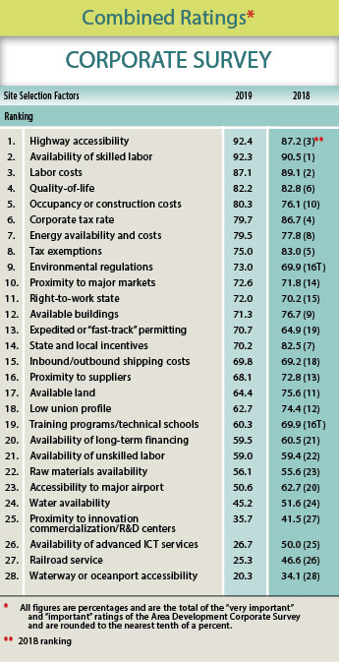
Top Site Selection Issues
Highway Accessibility
Availability of Skilled Labor
Labor Costs
Quality of Life
Occupancy or Construction Costs
Corporate Tax Rate
Energy Availability and Costs
Tax Exemptions
Environmental Regulations
Proximity to Major Markets
Right-to-Work State
Available Buildings
Fast-Track Permitting
State and Local Incentives
Shipping Costs

Slide 26

Data Analytics Might Rule the World

Slide 27
States By Average Ranks by Forbes, CNBC, and Chief Executive
Forbes released 12/19/19; CNBC released 7/10/19; Chief Executive released 6/2/20
Plotted Against
Actual Performance for Job Growth, Wage Growth and Growth in GDP
3 years 2016-2019 Jobs & Wages: BLS QCEW annual; 3 years 2016-2019 GDP: BEA
Worse Performance Than Rank
Better Performance Than Rank

Slide 28
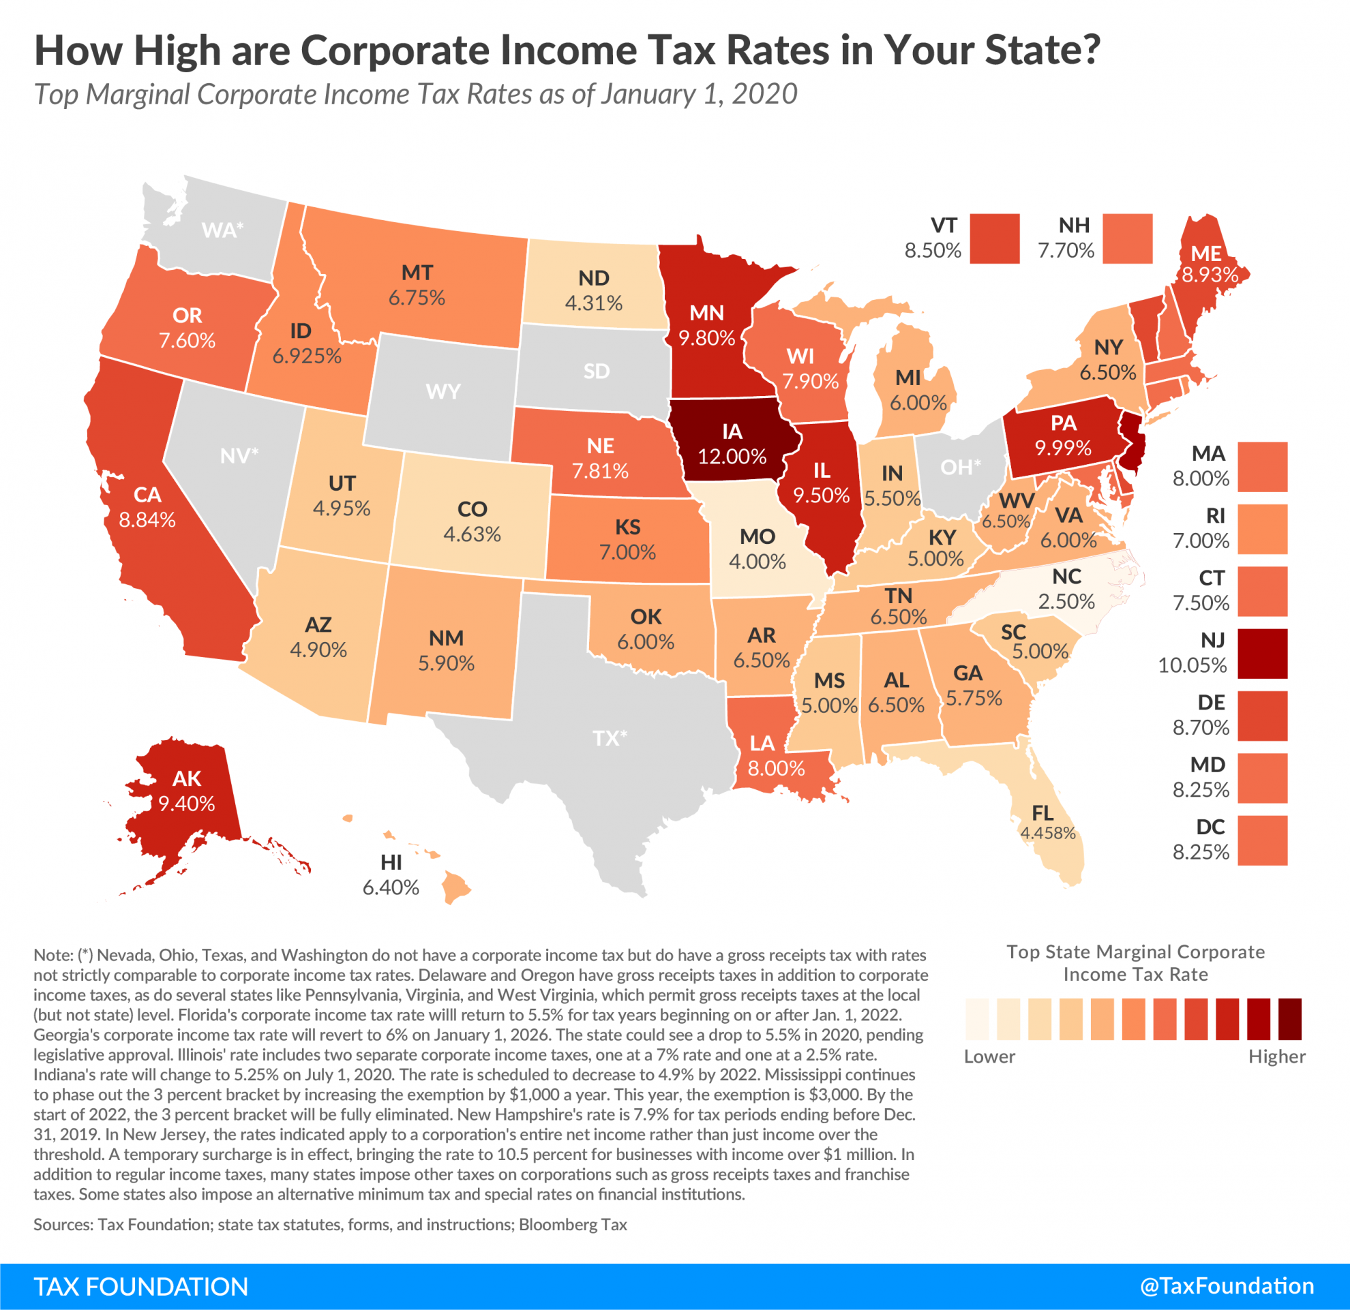

Slide 29
Tax Burden Ranking
Tax Foundation – 2020 Stated Business Tax Climate Composite Rankings
Plotted Against
Actual Performance for Job Growth, Wage Growth and Growth in GDP
3 years 2016-2019 Jobs & Wages: BLS QCEW annual; 3 years 2016-2019 GDP: BEA

Slide 30
What Can You Expect?

Slide 31
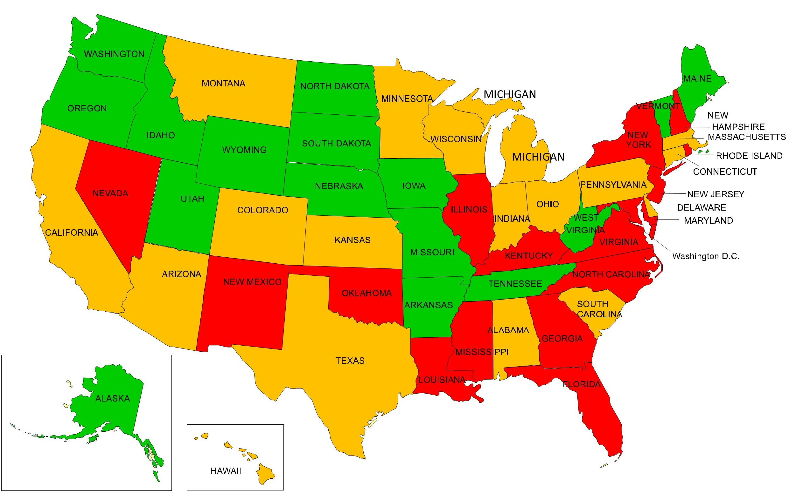
State Economies Most Exposed to Coronavirus
Least Exposed
Middle Exposed
Most Exposed
Source: Wallet Hub 6/8/20
Highly Effected Industries and Resources to Cope

Slide 32
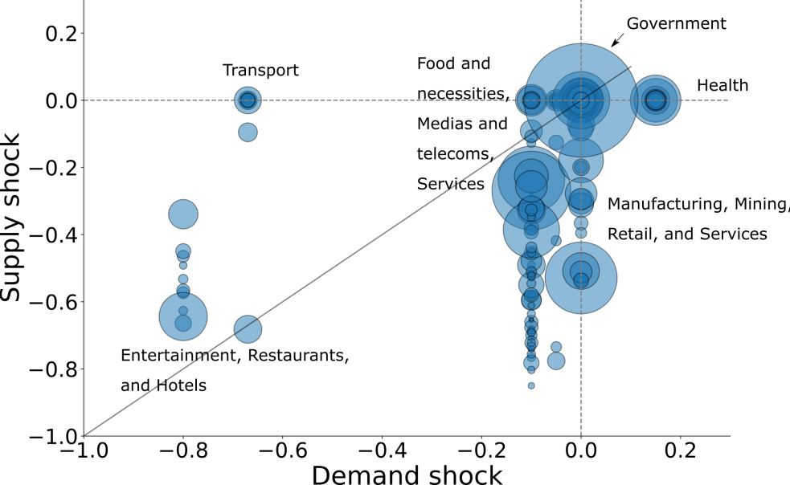
Industry Supply & Demand Shock Estimates
Source: The Centre for Economic Policy Research (www.cepr.org)

Slide 33
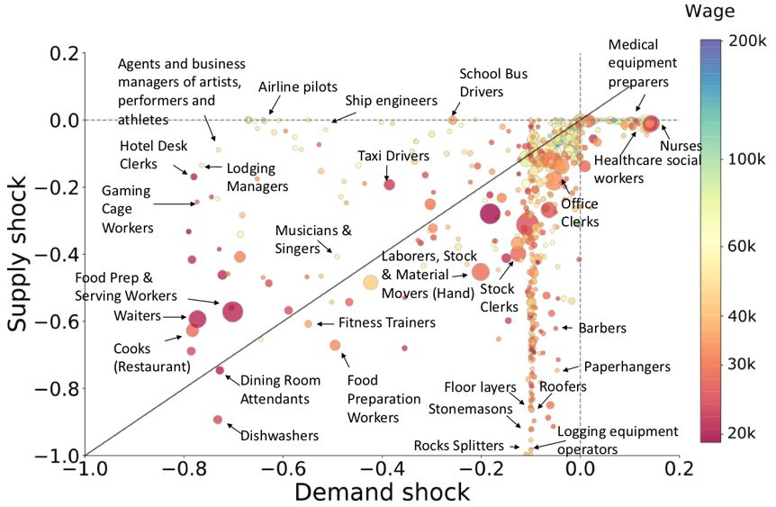
Occupation Demand and Supply Shock Estimates
Source: The Centre for Economic Policy Research (www.cepr.org)

Slide 34




Constant (Accelerated) Disruption
2007

Slide 35


Talent Wars
The Talent Wars Will Continue
For Workforce Solutions

Slide 36
U.S. Annual Rates of Labor Force Growth

Slide 37




People and Companies Might Reconsider Location
Safety, Health, Housing and Education

Slide 38
USA Domestic Migration by MSA Population
2010 to 2019
Source: Wendall Cox, Newgeography.com May 5, 2020

Slide 39



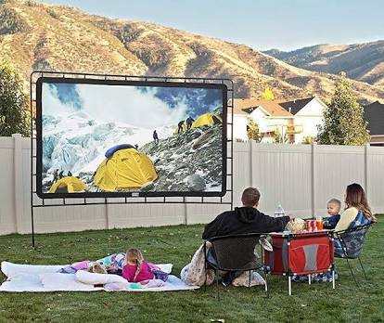
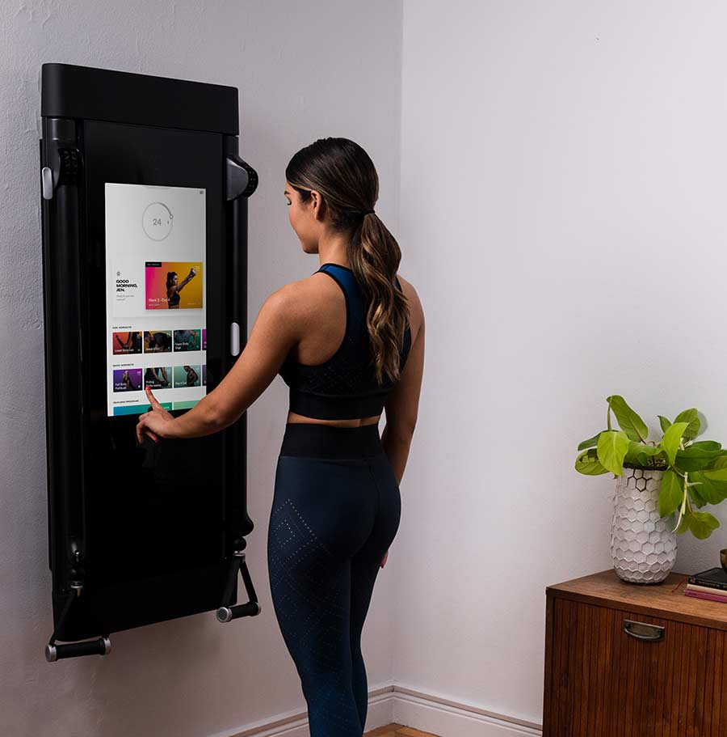

Remote Rules!
Work
Medicine
Entertainment
Exercise
Banking

Slide 40
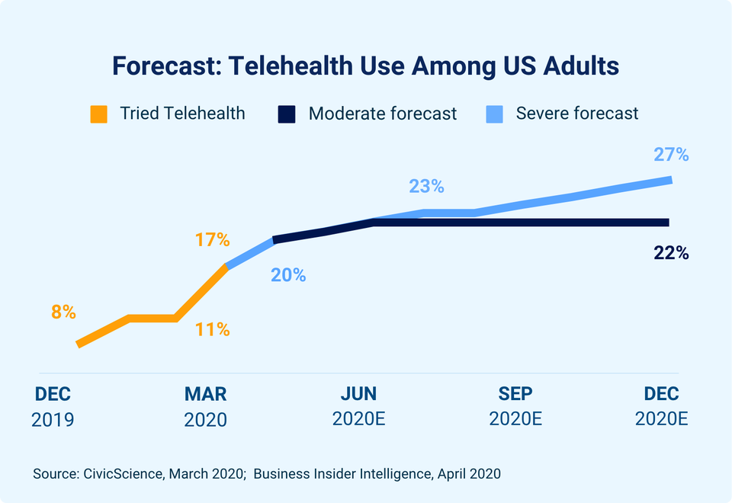

Slide 41

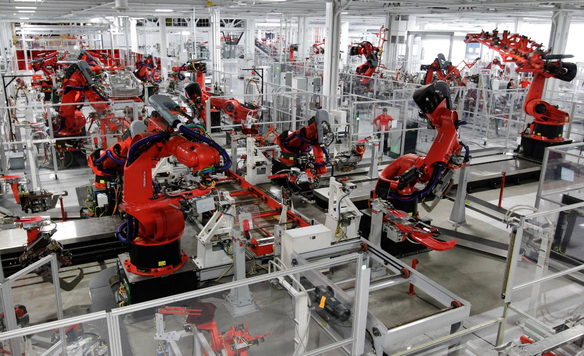


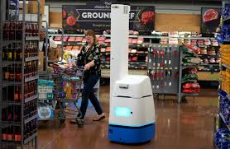
Robots Rule!

Slide 42
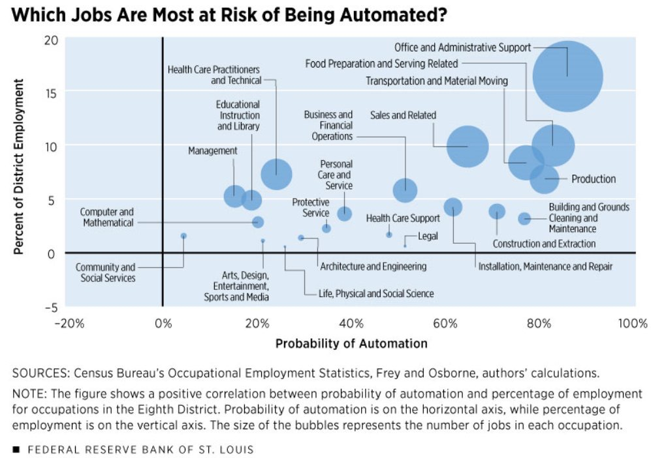

Slide 43


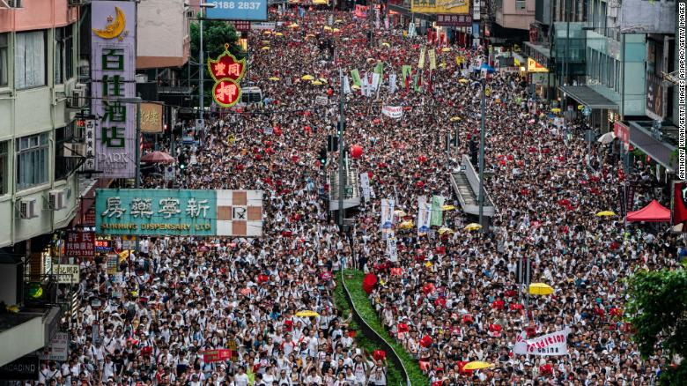




The Emerging Geo-Muddle Impacts Increase
The World Order Never Stops Changing Don’t Be the Frog

Slide 44
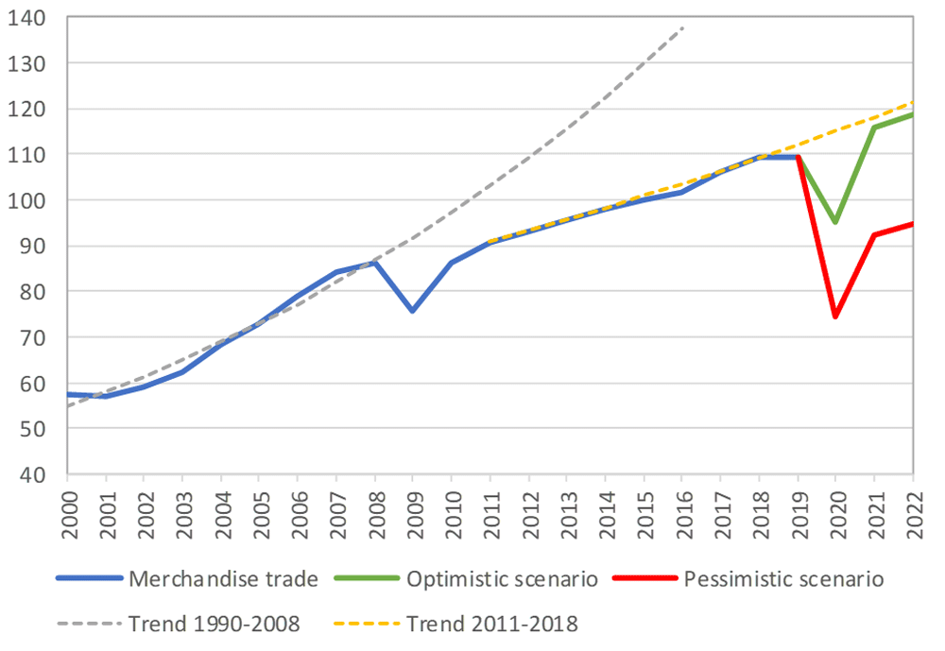
World merchandise trade volume, 2000‑2022
Index, 2015=100
Source: The World Trade Organization

Slide 45
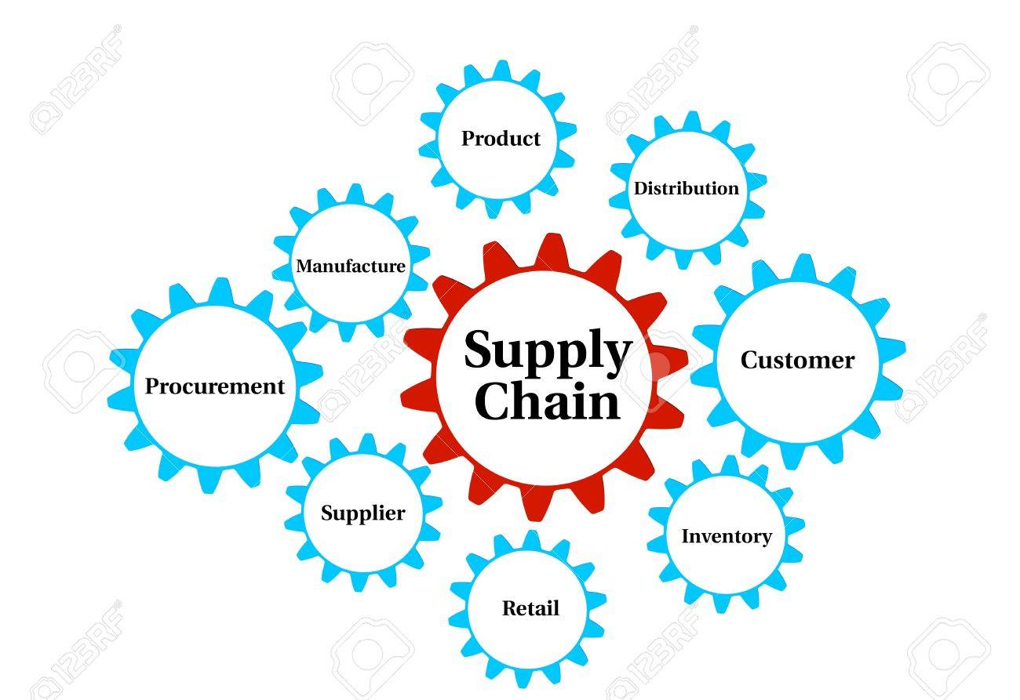
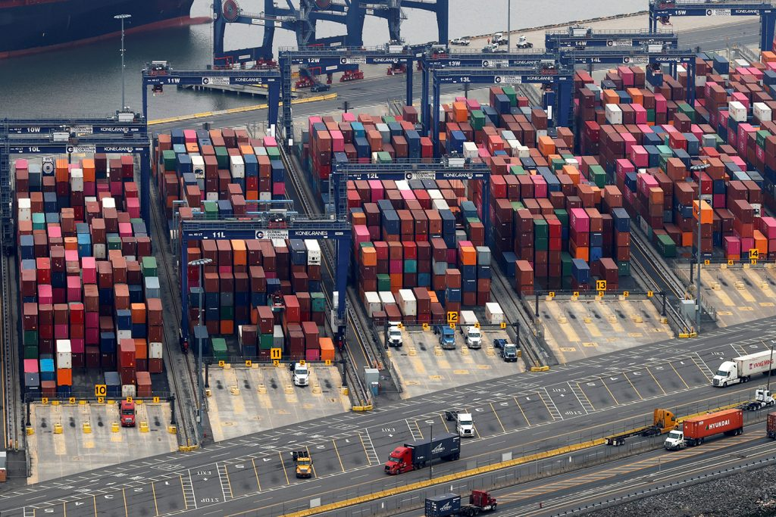
Reshoring & US Supply Chain Evolution
Opportunities in Bio/Pharma, Medical Devices, Defense & Food
Shorter & Redundant

Slide 46
Total Export of Goods Per Capita – 4 U.S. Regions
2019
Source: U.S. Census Bureau

Slide 47
Total Export of Goods Per Capita
South Region 2019
Source: U.S. Census Bureau

Slide 48
Small Business Pulse Survey
“How has this business been impacted by COVID-19?”
Significant Loss of Small Business
Source: U.S. Census Bureau

Slide 49
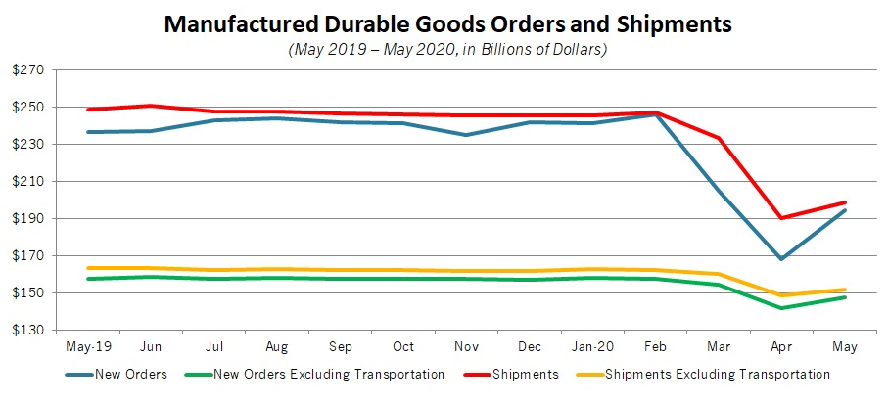
Durable Good Have Started the Long Road Back
Source: NAM June 2020

Slide 50
U.S. Monthly Change in Personal Income and Spending
Source: NAM June 2020

Slide 51
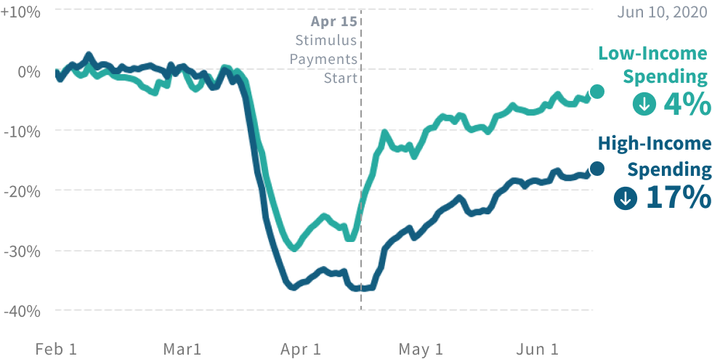
Higher Income Individuals Have Cut Spending
Source: Tracktherecover.org

Slide 52
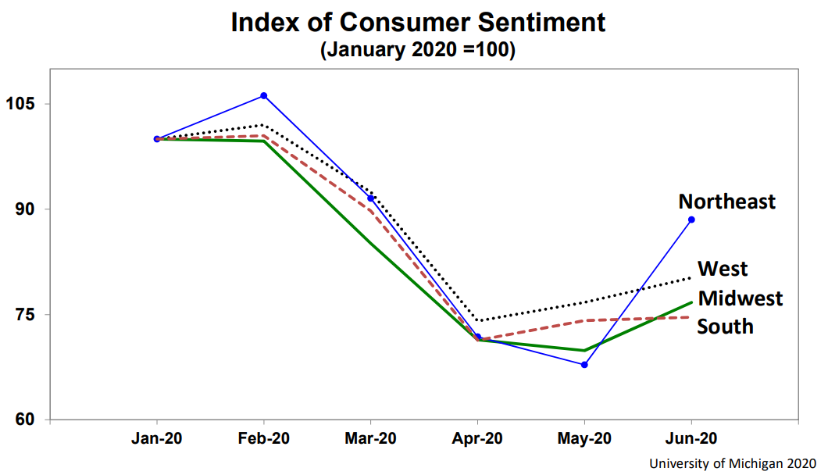
Index of Consumer Sentiment
January 2020 = 100
Key to Recovery

Slide 53
Future Consumer Behavior
Rational Risk Evaluation
Ambiguous Information
Where they live
How much they save
How & how far they travel to work
Vacations

Slide 54
Future Consumer Behavior
Rational Risk Evaluation
Ambiguous Information
Will fear and uncertainty change moral judgments on economic policy?
Growth & efficiency prioritization could become equity, opportunity and universal access

Slide 55

Business Risk
Global Recession
Politics
Polarization and Equity
Global Pandemic

Slide 56
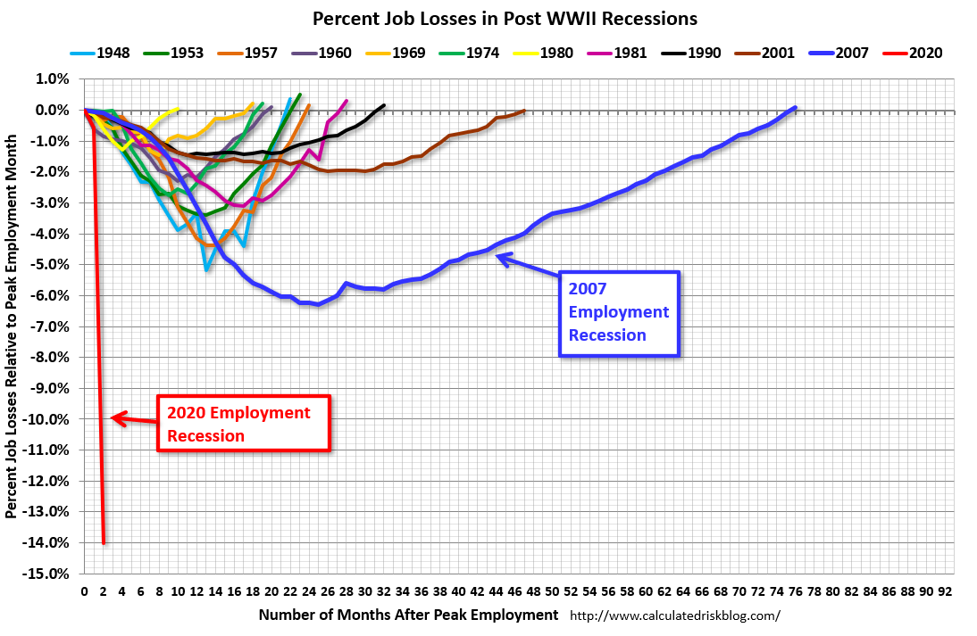
The 2007 recession took about 6 years to gain the jobs back
11.6 million jobs lost permanently
CBO projects full recover in 2030

Slide 57


Slide 58
U.S. Educational Requirements 2024 Jobs
High school or less 63%
BA or higher 37%
Source: EMSI 2020.2

Slide 59
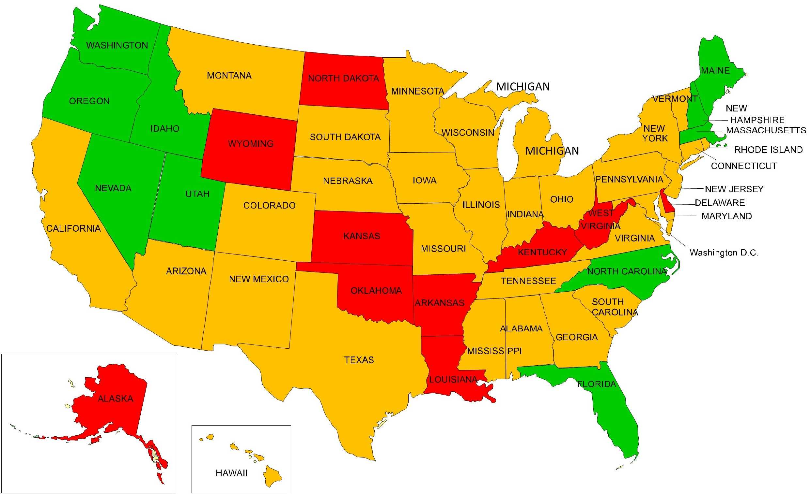
Tech Sector Employment Growth, 2014-2019
Ranked 1 - 10
Ranked 11 - 40
Ranked 41 - 50
Source: EMSI 2020.2

Slide 60
Relationship between Crime Rate & Poverty
Source: US Census Bureau and FBI

Slide 61


Slide 62




www.econleadership.com
ted@econleadership.com
Follow on twitter @tedabernathy
Link to me on LinkedIn Ted Abernathy

