Slide 1
2020
2021

Slide 2
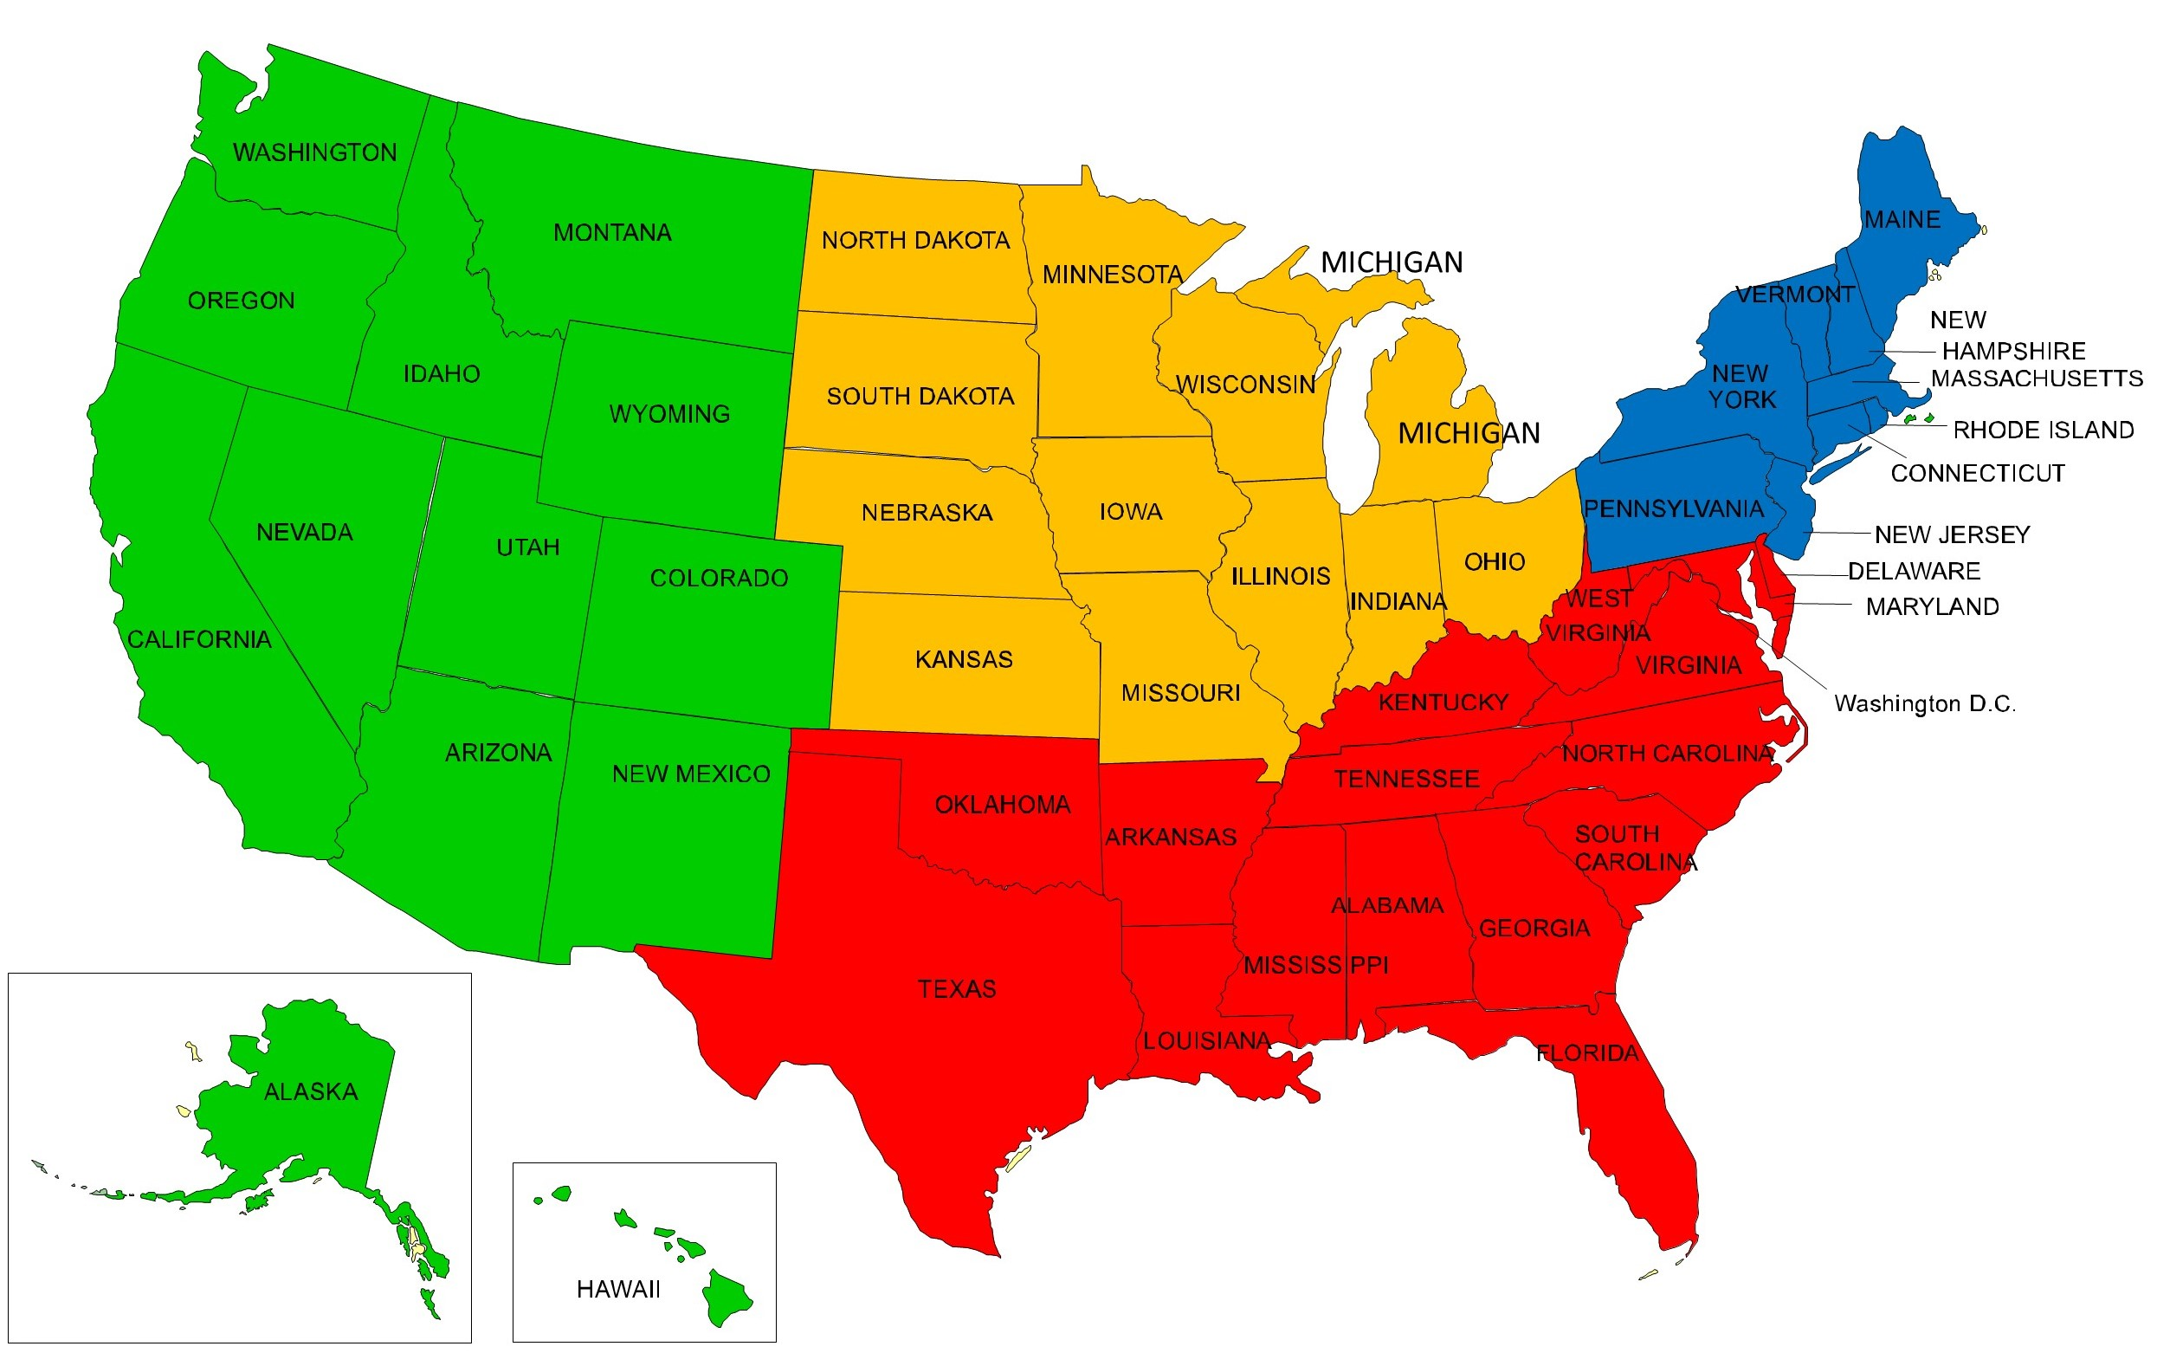
4 U.S. Regions
Northeast
Connecticut
Maine
Massachusetts
New Hampshire
New Jersey
New York
Pennsylvania
Rhode Island
Vermont
South
Alabama Mississippi
Arkansas North Carolina
Delaware Oklahoma
Florida South Carolina
Georgia Tennessee
Kentucky Texas
Louisiana Virginia
Maryland West Virginia
West Montana
Alaska Nevada
Arizona New Mexico
California Oregon
Colorado Utah
Hawaii Washington
Idaho Wyoming
Midwest
Illinois Missouri
Indiana Nebraska
Iowa North Dakota
Kansas Ohio
Michigan South Dakota
Minnesota Wisconsin
Source: US Census Bureau

Slide 3
USA Nonfarm Payroll Employment
April -20,687,000 jobs
Source: US Bureau of Labor Statistics

Slide 4
USA Nonfarm Payroll Employment
May +2,509,000 jobs
April -20,687,000 jobs
Source: US Bureau of Labor Statistics

Slide 5
Employment Change by Sector for the US
May 2019 – May 2020
Source: US Bureau of Labor Statistics

Slide 6
Employment Gains/Losses By Sector for the US & West
Source: US Bureau of Labor Statistics

Slide 7
Employment Gains/Losses By Sector for 4 US Regions
Source: US Bureau of Labor Statistics

Slide 8
All States 1-Year Total Non-Farm Employment Percentage Change May 2019 to May 2020
Source: US Bureau of Labor Statistics

Slide 9
4 U.S. Regions 1-Year Total Non-Farm Employment Percentage Change May 2019 to May 2020
Source: US Bureau of Labor Statistics

Slide 10
West Region 1-Year Total Non-Farm Employment Percentage Change May 2019 to May 2020
Source: US Bureau of Labor Statistics

Slide 11
Change in Average Annual Jobs 2014-2019 for 4 U.S. Regions
Source: US Bureau of Labor Statistics

Slide 12
Percentage Change in Jobs 2014 –2019 for the
West Region
Source: US Bureau of Labor Statistics

Slide 13
5 Year Employ. Gains By Sector 4 U.S. Regions 2014-2019
Source: US Bureau of Labor Statistics

Slide 14
5 Year Employment Gains By Sector for the United States and the West Region 2014-2019
Source: US Bureau of Labor Statistics

Slide 15
Change in Per Capita GDP 2014-2019 for 4 U.S. Regions
Source: US Bureau of Economic Analysis

Slide 16
Change in Per Capita GDP 2014-2019 for the West Region
Source: US Bureau of Economic Analysis

Slide 17
Change in Per Capita Personal Income 2014-2019 for 4 U.S. Regions
Source: US Bureau of Economic Analysis

Slide 18
Change in Personal Per Capita Income for the West Region 2014-2019
Source: US Bureau of Economic Analysis

Slide 19
Productivity Million Dollars of GDP per 1,000 Workers - 2018
Source: U.S. Bureau of Economic Analysis

Slide 20
Productivity in the 4 U.S. Regions Million Dollars of GDP per 1,000 Workers - 2018
Source: U.S. Bureau of Economic Analysis

Slide 21
Productivity in the West Region Million Dollars of GDP per 1,000 Workers - 2018
Source: U.S. Bureau of Economic Analysis

Slide 22
Per Capita GDP vs Per Capita Personal Income
Source: US Bureau of Economic Analysis

Slide 23
After COVID-19 - Preparing for the (Next) New Normal
NEXT

Slide 24
After COVID-19 Competitiveness Still Matters

Slide 25
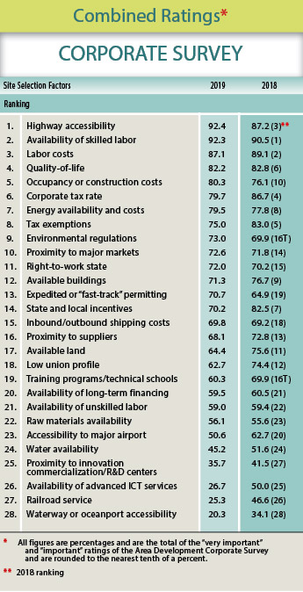
Top Site Selection Issues
Highway Accessibility
Availability of Skilled Labor
Labor Costs
Quality of Life
Occupancy or Construction Costs
Corporate Tax Rate
Energy Availability and Costs
Tax Exemptions
Environmental Regulations
Proximity to Major Markets
Right-to-Work State
Available Buildings
Fast-Track Permitting
State and Local Incentives
Shipping Costs

Slide 26
Data Analytics Might Rule the World

Slide 27
States By Average Ranks by Forbes, CNBC, and Chief Executive
Forbes released 12/19/19; CNBC released 7/10/19; Chief Executive released 6/2/20
Plotted Against
Actual Performance for Job Growth, Wage Growth and Growth in GDP
3 years 2016-2019 Jobs & Wages: BLS QCEW annual; 3 years 2016-2019 GDP: BEA
Worse Performance Than Rank
Better Performance Than Rank

Slide 28
What Can You Expect?

Slide 29
Industry Supply & Demand Shock Estimates
Source: The Centre for Economic Policy Research (www.cepr.org)

Slide 30
Occupation Demand and Supply Shock Estimates
Source: The Centre for Economic Policy Research (www.cepr.org)

Slide 31
Constant (Accelerated) Disruption
2007

Slide 32
Talent Wars
The Talent Wars Will Continue
For Workforce Solutions

Slide 33
U.S. Annual Rates of Labor Force Growth

Slide 34
People and Companies Might Reconsider Location
Safety, Health, Housing and Education

Slide 35
USA Domestic Migration by MSA Population 2010 to 2019
Source: Wendall Cox, Newgeography.com May 5, 2020

Slide 36
Remote Rules!
Work
Medicine
Entertainment
Exercise
Banking

Slide 38
Robots Rule!

Slide 39
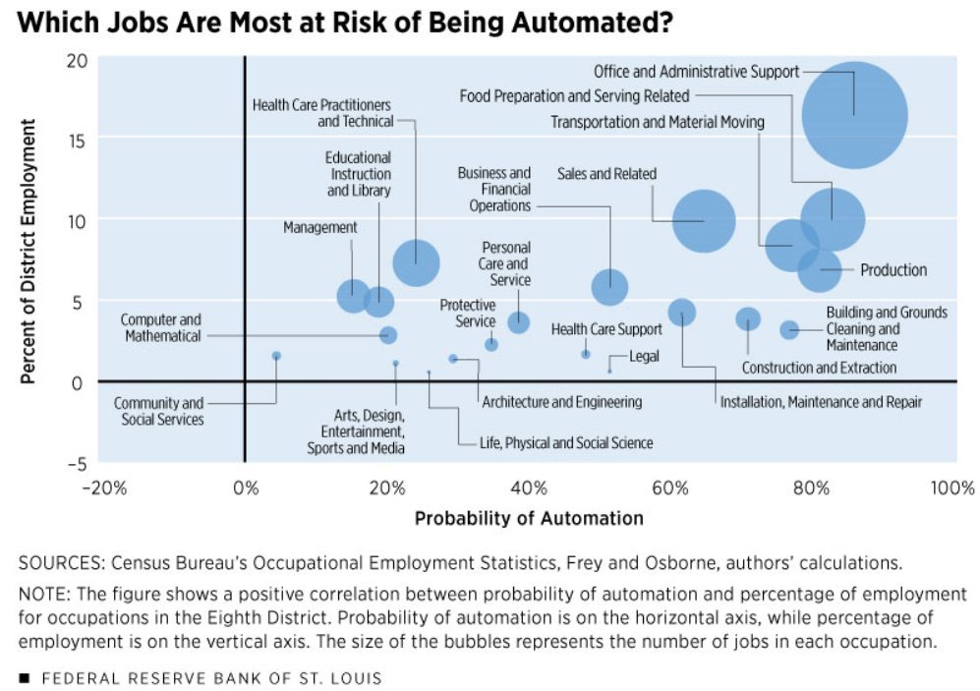

Slide 40
The Emerging Geo-Muddle Impacts Increase The World Order Never Stops Changing Don’t Be the Frog

Slide 41
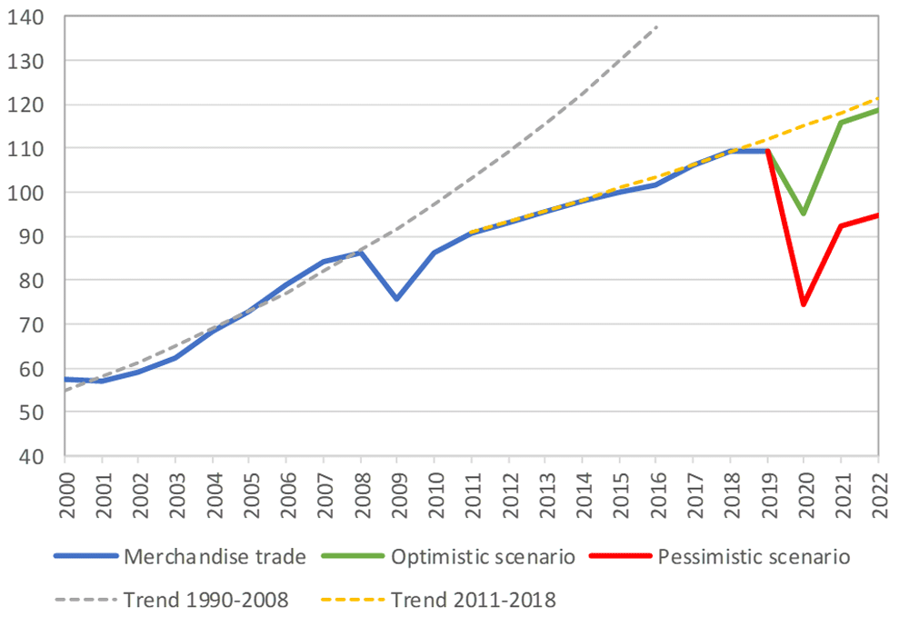
World merchandise trade volume, 2000‑2022 Index, 2015=100
Source: The World Trade Organization

Slide 42
Reshoring & US Supply Chain Evolution
Opportunities in Bio/Pharma, Medical Devices, Defense & Food
Shorter & Redundant

Slide 43
Total Export of Goods Per Capita – 4 U.S. Regions 2019
Source: U.S. Census Bureau

Slide 44
Total Export of Goods Per Capita West Region 2019
Source: U.S. Census Bureau

Slide 45
Small Business Pulse Survey
“How has this business been impacted by COVID-19?”
Significant Loss of Small Business
Source: U.S. Census Bureau

Slide 46
Durable Good Have Started the Long Road Back
Source: NAM June 2020

Slide 47
U.S. Monthly Change in Personal Income and Spending
Source: NAM June 2020

Slide 48
Higher Income Individuals Have Cut Spending
Source: Tracktherecover.org

Slide 49
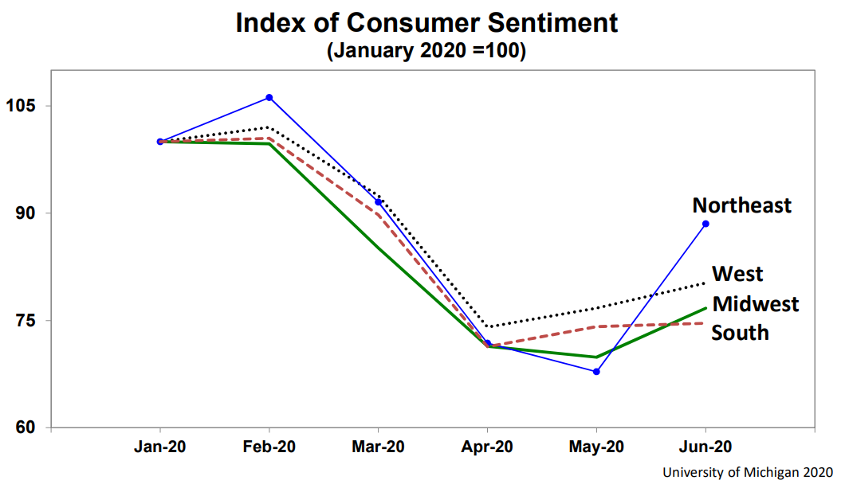
Index of Consumer Sentiment January 2020 = 100
Key to Recovery

Slide 50
Future Consumer Behavior
Rational Risk Evaluation
Ambiguous Information
Where they live
How much they save
How & how far they travel to work
Vacations

Slide 51
Future Consumer Behavior
Rational Risk Evaluation
Ambiguous Information
Will fear and uncertainty change moral judgments on economic policy?
Growth & efficiency prioritization could become equity, opportunity and universal access

Slide 52
Business Risk
Global Recession
Politics
Polarization and Equity
Global Pandemic

Slide 53
The 2007 recession took about 6 years to gain the jobs back
11.6 million jobs lost permanently
CBO projects full recover in 2030

Slide 55
U.S. Educational Requirements 2024 Jobs
High school or less 63%
BA or higher 37%
Source: EMSI 2020.2

Slide 56
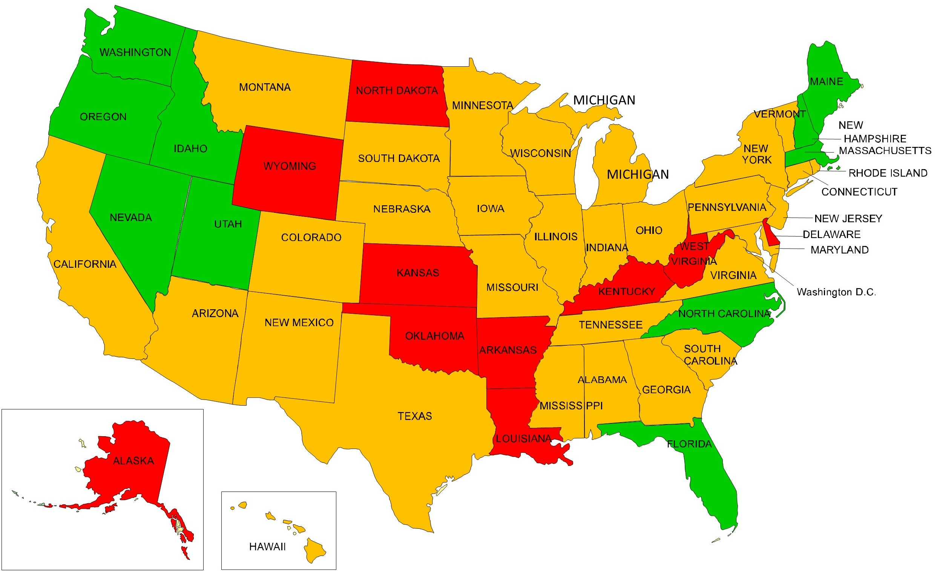
Tech Sector Employment Growth, 2014-2019
Ranked 1 - 10
Ranked 11 - 40
Ranked 41 - 50
Source: EMSI 2020.2

Slide 57
Relationship between Crime Rate & Poverty
Source: US Census Bureau and FBI

Slide 59
www.econleadership.com
ted@econleadership.com
Follow on twitter @tedabernathy
Link to me on LinkedIn Ted Abernathy

