Slide 1
Recreational Use of Marijuana:
2018 Ballot Proposal
Midland Area Chamber of Commerce
September 11, 2018

Slide 2
About the Michigan Chamber
Statewide business organization
6,000 members
Businesses of every size and type in all 83 counties
Advocate for Michigan's job providers in the legislative, political, and legal process

Slide 3
Who I Am, What I Do
Wendy Block, Vice President of Business Advocacy
Lead lobbyist on health care and employment-related issues, legal reform
  Legislative background

Slide 4
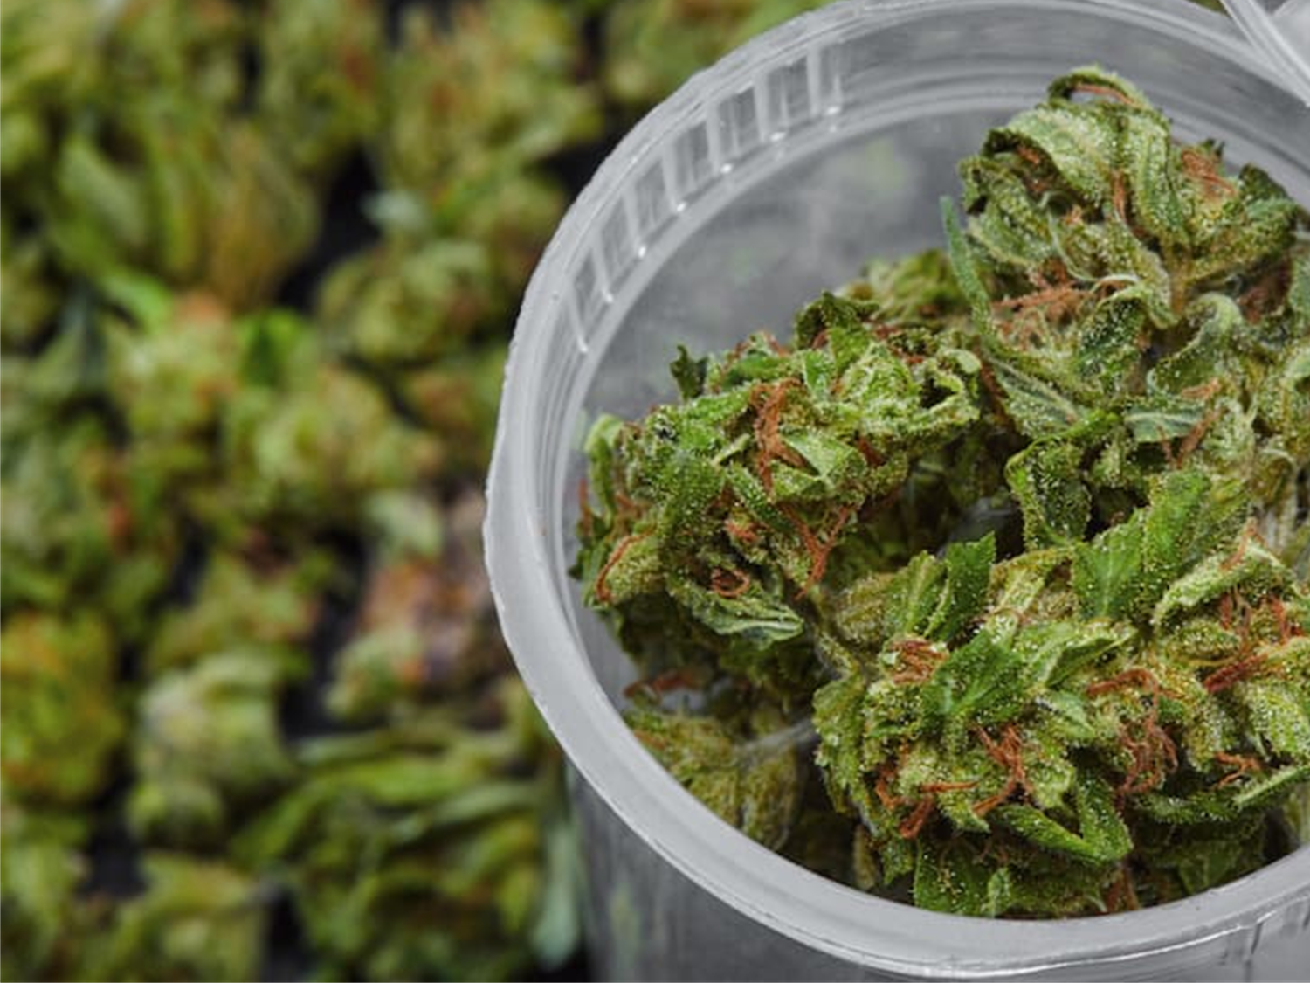
Today’s Agenda
How we got here
  Medical Marijuana Ballot Initiative
Recreational use
  Details
  Impact on employers
  Unintended
  consequences
Take-aways

Slide 5
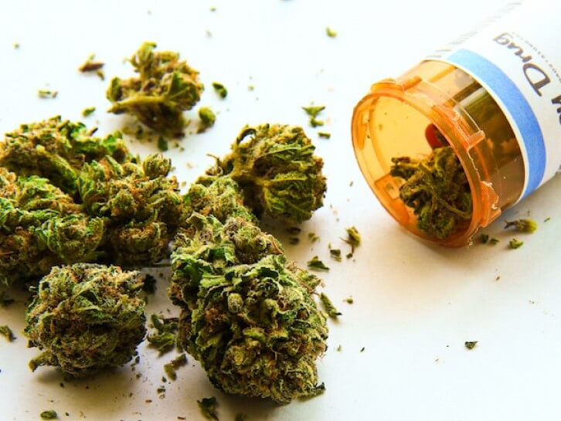
How We Got Here:
Michigan’s Medical Marijuana Act
2008 statutory initiative
“Debilitating condition,” doctor’s approval
  No “arrest, prosecution, or penalty in any manner.”
Cultivate own marijuana
  Patients -12 plants
  Caregivers - 12 plants for 5 patients (72 if patient themselves)

Slide 6
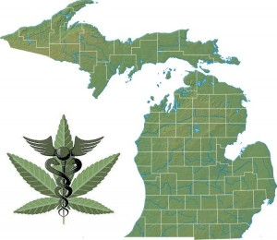
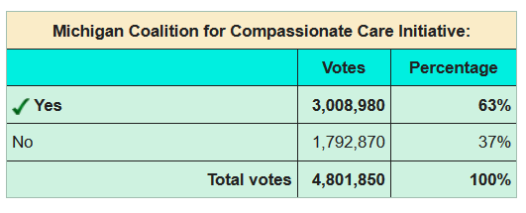
Medical Marijuana Law
12th state (1st in Midwest)

Slide 7
Medical Marijuana: Litigation
Casias v. Walmart
  Mandatory post-injury testing protocols
  Tested positive, admitted to use
  Presented MM card post-injury
  Drug policy had no exceptions so terminated
  US Court of Appeals (6th Circuit) - 2-1:
  Medical Marijuana Act does not regulate private employment either expressly or implicitly

Slide 8
Medical Marijuana: Litigation
Braska v. Challenge Manufacturing Co.
  3 cases consolidated
  Employee was a MM patient, terminated and subsequently DQed from UI benefits
  MI Court of Appeals (2014) - 3-0 (unpublished): MMMA preempts MI UI law. Disqualifying a claimant for UI benefits due to a positive marijuana test constitutes a “penalty” in violation of the MMMA’s immunity clause

Slide 9
Employers in a Dilemma on Medical Marijuana
MI Supreme Court denied UI appeal
  “[W]e are not persuaded that the questions presented should be reviewed by this Court.”
Put employers in dilemma
  Accommodate and jeopardize workplace safety vs. discharge and pay UI benefits (higher UI taxes)
No easy fix
  Requires 3/4ths vote

Slide 10
Recreational Use of Marijuana

Slide 11
Ballot Proposal Process
For Initiated Law
180 day window to gather 252,523 signatures of registered voters
For 2018 ballot, due May 30
Legislature has 40 days to:
  Adopt as written (no signature by Governor required to become law)
  Reject by vote or Do Nothing (same result as rejection)
  Put Competing Proposal on Ballot
Laws enacted as an initiated law do not require signature of Governor
Super majority of 3/4 vote for Legislature to amend an initiated law
Coalition to Regulate Marijuana Like Alcohol
Turned in over 360,000 signatures
  Legislative window has closed

Slide 12
Recreational Use of Marijuana
Proposal 1 of 2018
  Allows individuals 21+ to possess, use, grow
  Taxes it
    10% excise at retail, 6% sales
    Excise tax revenue split: 1/3 each to K-12, roads, communities that allow
  Restrict purchases to 2.5 oz. but can keep 10 oz. in homes & cultivate up to 12 plants (personal use)
    1 oz = 84 joints
  Requires the state to regulate & license growers, transporters, testers & dispensaries

Slide 13
Details Important to Employers
NOT a get out of jail free card with employers
  Protections for employers do exist
“This act does not require an employer to permit or accommodate conduct otherwise allowed by this act in any workplace or on the employer's property.”
“This act does not prohibit an employer from disciplining an employee for violation of a workplace drug policy or for working while under the influence of marihuana.”

Slide 14
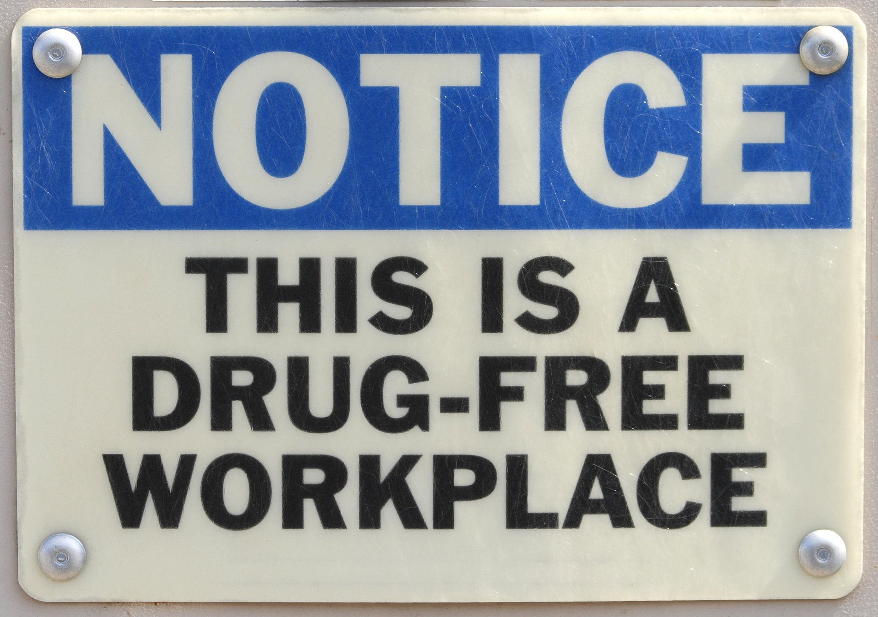
Details Important to Employers
“This act does not prevent an employer from refusing to hire, discharging, disciplining, or otherwise taking an adverse employment action against a person with respect to hire, tenure, terms, conditions, or privileges of employment because of that person's violation of a workplace drug policy or because that person was working while under the influence of marihuana.”

Slide 15
Details Important to Employers
“All other laws inconsistent with this act do not apply to conduct that is permitted by this act.”
“Notwithstanding any other law or provision of this act, and except as otherwise provided in section 4 of this act, the following acts by a person 21 years of age or older are not unlawful, are not an offense, are not grounds for seizing or forfeiting property, are not grounds for arrest, prosecution, or penalty in any manner, are not grounds for search or inspection, and are not grounds to deny any other right or privilege”

Slide 16
Recreational Use
Why should employers care? Largely a “social” issue…BUT:
  Limited/ambiguous statutory protections for employers

Slide 17
Practical Issues
Open-ended liability.
  OSHA: Employers have a responsibility to protect all employees
    Place of employment that "is free from recognizable hazards that are causing or likely to cause death or serious harm to employees”
    Failure means liability and lawsuits
    Law does not remove an employer from payment of workers’ compensation
  Marijuana is still illegal under federal law

Slide 18
Practical Issues
Higher number of failed drug tests
  Many employers rely on drug-free workplace policies and pre-employment drug screening
    Could it result in increased failed drug tests?
      National failure rate = 2.6% (marijuana) and 4.2% (all drugs)
      CO up 20%, WA up 23% after legalization

Slide 19
Practical Issues
Testing
  Saliva, urine, hair tests only show if THC in system
    Some go back as long as 90 days
  Blood tests show impairment levels more precisely
    More expensive
    Take longer to analyze (not on-demand)
    Aren’t commonly used in the workplace
  Significant HR dilemmas for employers

Slide 20
Practical Issues
Reputational issues for the state
  Uncertainty for businesses
  If an early adopter it will harm the reputation of the state as a destination for business growth
No way to make the language “bulletproof”
  Language could be improved
  Doesn’t regulate private employment or employment-related programs and liabilities
  BUT…no way to make the protect employers and workplace safety in all scenarios

Slide 21
Legalization
Lots of decisions will need to be made by employers if adopted:
  Apply zero-tolerance drug policies in recruiting, hiring and retaining employees?
  Enforce a zero-tolerance policies on or off the job?
  Terminate an employee who tests positive for marijuana, even if can’t prove “impaired”?
    If do, should employer be resigned to pay UI benefits?
Remember: Courts will be final arbiter

Slide 22
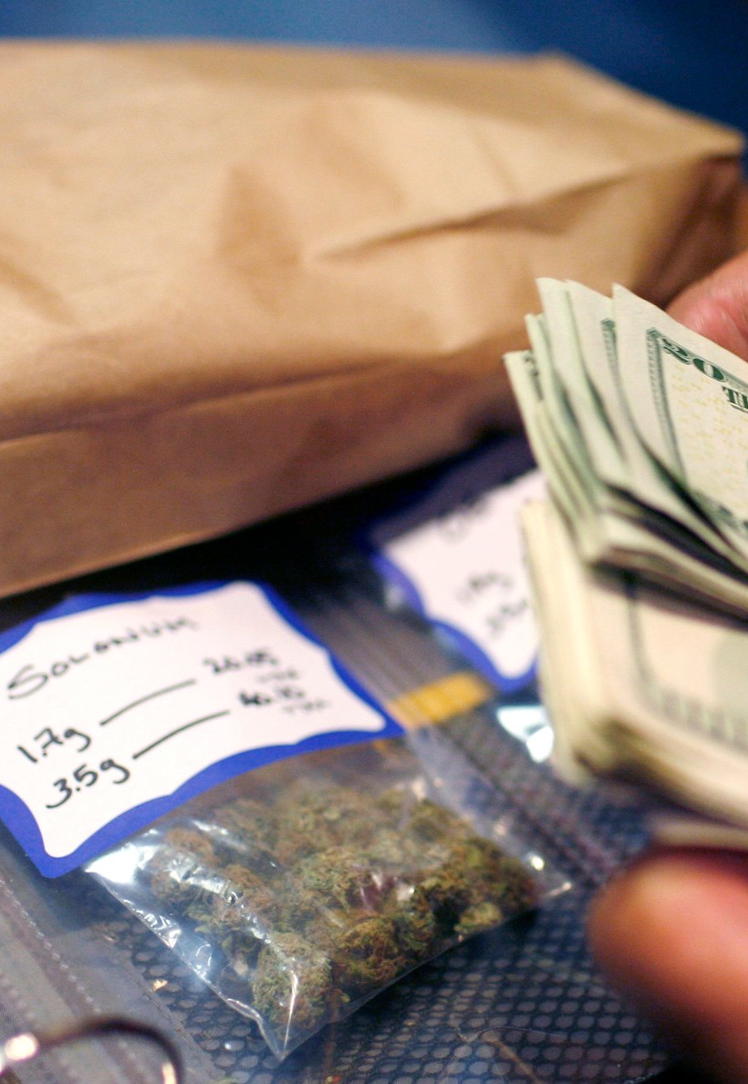
The Campaign
Large national movement
  $8-10m pledged to pass
  Spent $1.7m already
9 states have legalized – Alaska, California, Colorado, Maine, Massachusetts, Nevada, Oregon, Vermont, Washington

Slide 23
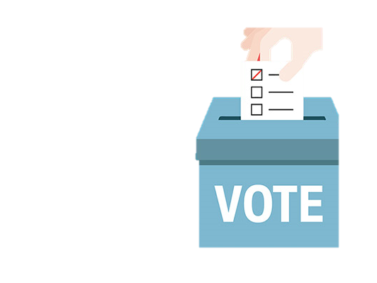
Recreational Use:
“When” Not “If”?
Voters have approved in all states, except AZ & OH
Statewide polling:
  41% (Sept. 2018) <-anomaly?
  56% (Sept. 2018)
  61% (Feb. 2018)
  57% (Jan. 2018)
  58% (May 2017)
  57% (Jan. 2017)
Public believes less harmful than tobacco, alcohol and sugar (NBC News, March 2014)

Slide 24

Closing Thoughts
Expect Headaches!
Employees will test the limits so know your rights
  Legalization isn’t a “get out of jail free card” with employers
Make sure your HR policies reflect your rights and how you expect to enforce
Re-examine pre-employment and other drug testing protocols
  Still realistic?

Slide 25
Questions?
Wendy Block
Vice President of Business Advocacy
Michigan Chamber of Commerce
517/371-7678 (o)
wblock@michamber.com

