Slide 1
Marijuana and Your Business TRENDS Luncheon Michindoh Conference Center, Hillsdale Jan. 22, 2019

Slide 2
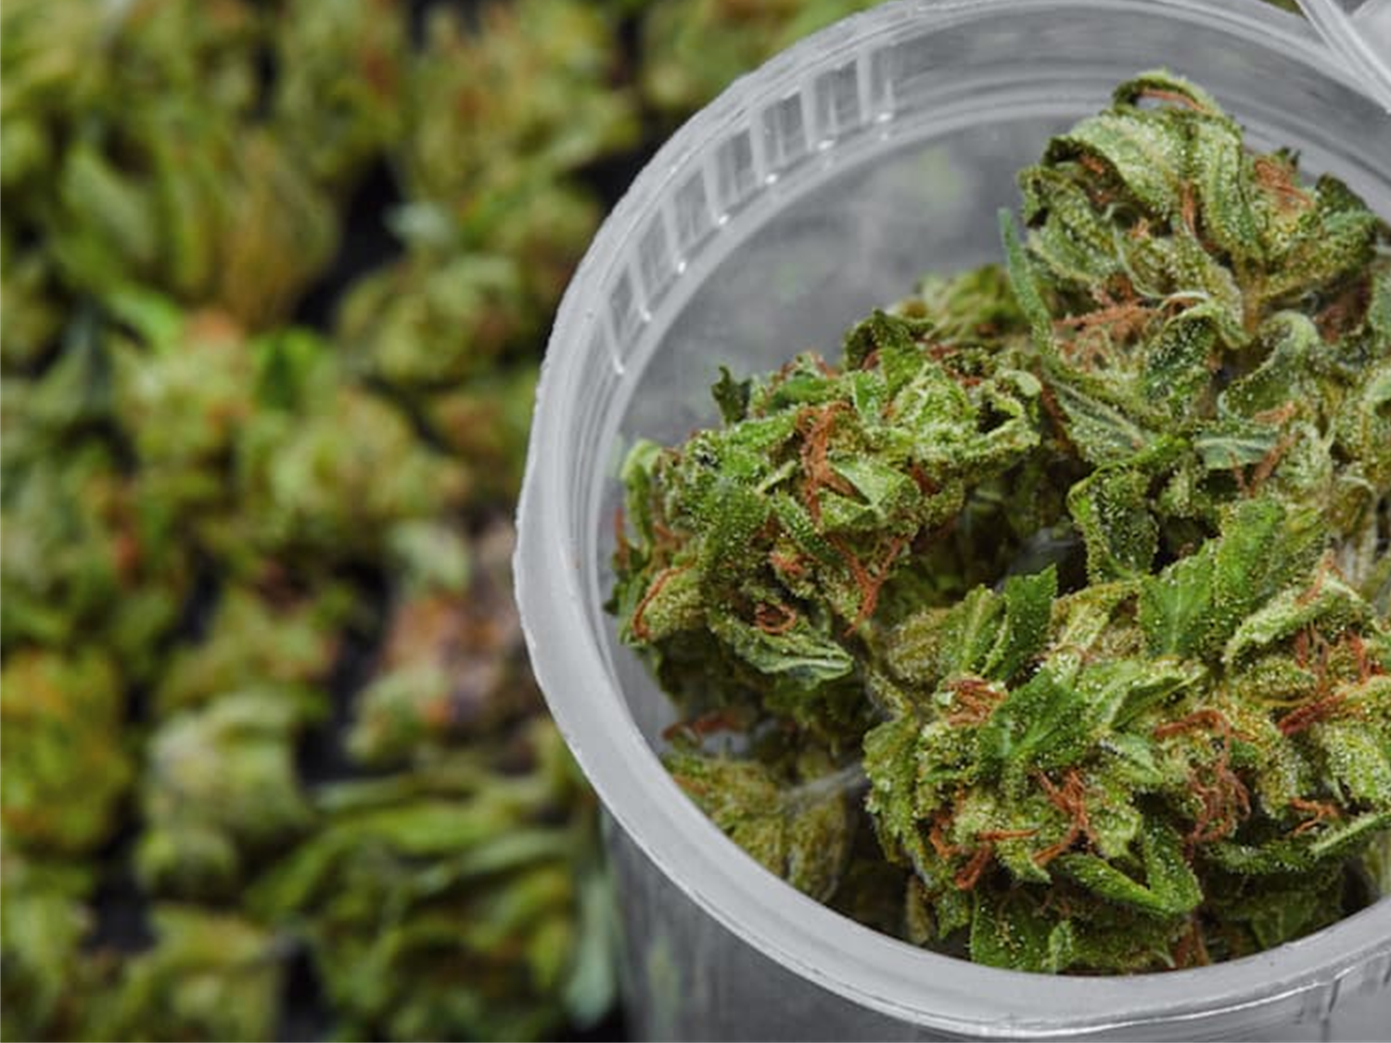
Today’s Agenda
How we got here:
2 Ballot Initiatives: Medical (2008) and Legalization (2018)
Recreational use:
Details
Impact on employers
Take-aways

Slide 3
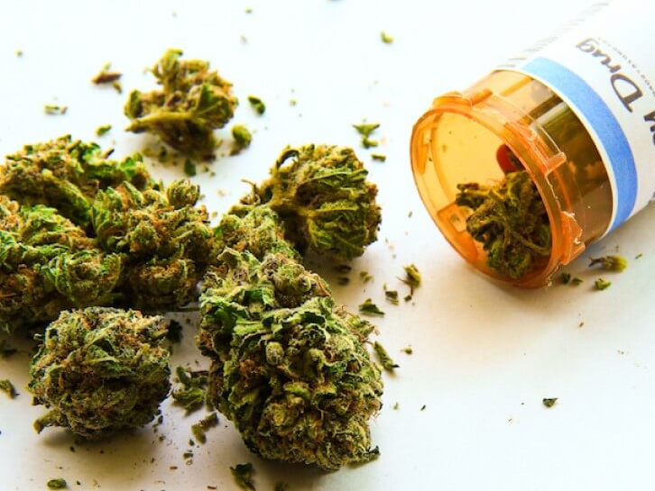
How We Got Here: Michigan’s Medical Marijuana Act
2008 statutory initiative
“Debilitating condition,” doctor’s approval
No “arrest, prosecution, or penalty in any manner.”
Cultivate own marijuana
Patients -12 plants
Caregivers - 12 plants for 5 patients (72 if patient themselves)

Slide 4
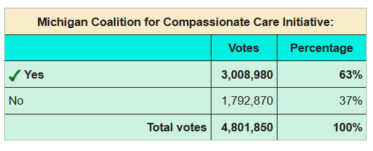
Medical Marijuana Law
12th state (1st in Midwest)

Slide 5
Recreational Use of Marijuana

Slide 6
Ballot Proposal Process
For Initiated Law
180 day window to gather 252,523 signatures of registered voters
For 2018 ballot, signatures were due May 30
Legislature had 40 days to:
Adopt as written (no signature by Governor required to become law)
Reject by vote or Do Nothing (same result as rejection)
Put Competing Proposal on Ballot

Slide 7
Outcome of the Ballot Proposal
Turned in over 360,000 signatures
Legislature decided to send to the ballot
Michigan Proposal 1 of 2018:
Result | Votes | Percentage
Yes | 2,354,640 | 55.89%
No | 1,858,354 | 44.11%

Slide 8
Who Was Behind It
YES Campaign: Coalition to Regulate Marijuana Like Alcohol - $3.73m raised
New Approach PAC contributed $1.78 million
NO Campaign: Healthy and Productive Michigan and Committee to Keep Pot Out of Neighborhoods and Schools - $2.67 million raised
Smart Approaches to Marijuana Action (SAM) contributed $1.78 million

Slide 9
10th State

Slide 10
The Law
Took effect 12/06/18
Allows individuals 21+ to possess, use, grow
Personal use went into effect on 12/6/18
Can “gift” up to 2.5 oz
BUT…the sale of recreational marijuana will not be permitted until after the state adopts regulations and issues licenses to businesses to engage in marijuana business
State has 12 months from the effective date to develop regulatory structure for businesses (12/6/19)

Slide 11
Recreational Use
Restricts purchases to 2.5 oz. but can keep 10 oz. in homes and cultivate up to 12 plants (personal use)
1 oz = approx. 28 to 56 joints
Requires the state to regulate & license growers, transporters, testers & dispensaries
Marijuana businesses must also receive approval from the local municipality in which the business desires to locate

Slide 12
Recreational Use
Taxes it
10% excise at retail, 6% sales
Excise Tax Revenue: Goes to “marijuana regulation fund and used to implement tax revenue, administer, enforce the Act and dedicates $20m for at least 2 years for clinical trials approved by the FDA.
Remaining 1/3rd each to K-12, roads, communities that allow

Slide 13
Recreational Use
Opt-out Provisions Exists for Local Communities
A municipality can opt out of the business side of the Proposal
Other states: Around 75-80% of the state has chosen to opt out of having the marijuana business in their communities
People over 21 will still be able to use it in a municipality that opts out; they just would not be able to legally acquire it there
Must be done at the lowest level of government - village, township, city, etc.
Leadership (Board, Commission, etc.) must vote to opt-out
If won’t, citizen petition process is available

Slide 14
Recreational Use
Communities near you that have already opted out:
Calhoun County: None
Branch County: Coldwater Township
Hillsdale County: None
Lenawee County: Fairfield Township, Tecumseh
Jackson County: None
Kalamazoo County: Brady Township, Charleston Township, Portage, Prairie Ronde Township

Slide 15
Important to Know!
MI voters decriminalized use/possession under state law BUT both marijuana still illegal under federal law
Marijuana is still a Schedule 1 substance under federal law (same as cocaine and heroin)
Use of marijuana and conducting a marijuana business subject to federal prosecution and federal criminal, civil and administrative forfeiture actions

Slide 16
Details Important to Employers
Protections for employers do exist!
“This act does not require an employer to permit or accommodate conduct otherwise allowed by this act in any workplace or on the employer's property.”
“This act does not prohibit an employer from disciplining an employee for violation of a workplace drug policy or for working while under the influence of marihuana.”
“All other laws inconsistent with this act do not apply to conduct that is permitted by this act.”

Slide 17
Details Important to Employers
“This act does not prevent an employer from refusing to hire, discharging, disciplining, or otherwise taking an adverse employment action against a person with respect to hire, tenure, terms, conditions, or privileges of employment because of that person's violation of a workplace drug policy or because that person was working while under the influence of marihuana.”
“Notwithstanding any other law or provision of this act, and except as otherwise provided in section 4 of this act, the following acts by a person 21 years of age or older are not unlawful, are not an offense, are not grounds for seizing or forfeiting property, are not grounds for arrest, prosecution, or penalty in any manner, are not grounds for search or inspection, and are not grounds to deny any other right or privilege”

Slide 18
Practical Issues
Open-ended liability
OSHA: Employers have a responsibility to protect all employees
Place of employment that "is free from recognizable hazards that are causing or likely to cause death or serious harm to employees”
Failure means liability and lawsuits
Law does not remove an employer from payment of workers’ compensation
Marijuana is still illegal under federal law

Slide 19
Practical Issues
Higher number of failed drug tests
Many employers rely on drug-free workplace policies and pre-employment drug screening
Could it result in increased failed drug tests?
National failure rate = 2.6% (marijuana) and 4.2% (all drugs)
CO up 20%, WA up 23% after legalization

Slide 20
Practical Issues
Testing
Saliva, urine, hair tests only show if THC in system
Some go back as long as 90 days
Blood tests show impairment levels more precisely
More expensive
Take longer to analyze (not on-demand)
Aren’t commonly used in the workplace
Significant HR dilemmas for employers

Slide 21
Legalization
Now that legal, employers need to decide:
Apply zero-tolerance drug policies in recruiting, hiring and retaining employees?
Enforce a zero-tolerance policies on or off the job?
Terminate an employee who tests positive for marijuana, even if can’t prove “impaired”?
If do, should employer be resigned to pay UI benefits?
Treat like alcohol?
Turn a blind eye?

Slide 22
Closing Thoughts
Expect Headaches!
Employees will test the limits so know your rights
Legalization isn’t a “get out of jail free card” with employers
Make sure your HR policies reflect your rights and how you expect to enforce
Re-examine pre-employment and other drug testing protocols
Still realistic?

Slide 23
Questions?
Wendy Block
Vice President of Business Advocacy
Michigan Chamber of Commerce
517/371-7678 (o)
wblock@michamber.com

